Slide 1
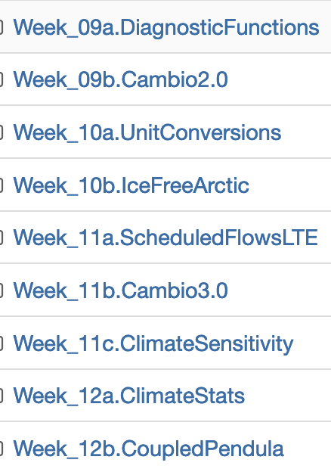
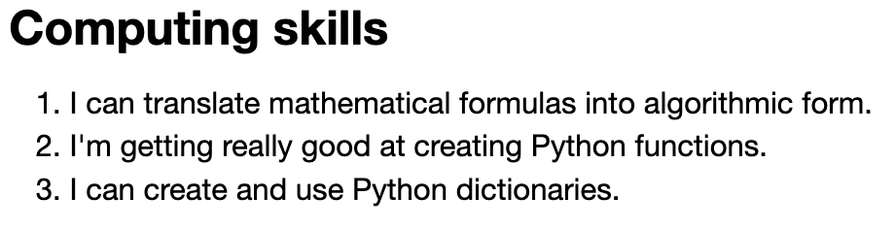
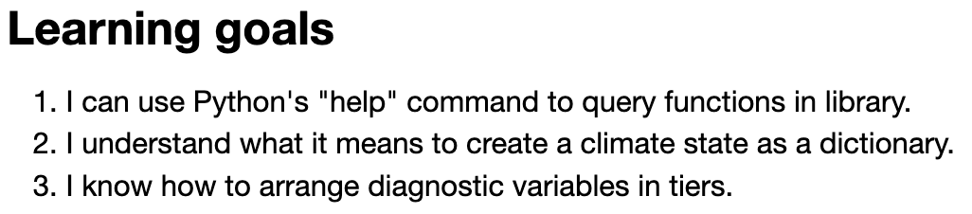
Assigning a grade for the course
Category | Significant gaps | Mostly there | Great command
CGIs
Discussion
Participation
Interviews
Project
Check out the learning goals & skills listed at the bottom of the Introduction of each CGI:

Slide 2
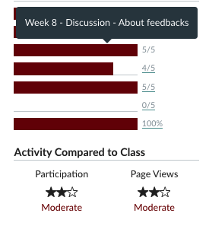
Assigning a grade for the course
Category | Significant gaps | Mostly there | Great command
CGIs
Discussion
Participation
Interviews
Project

Slide 3
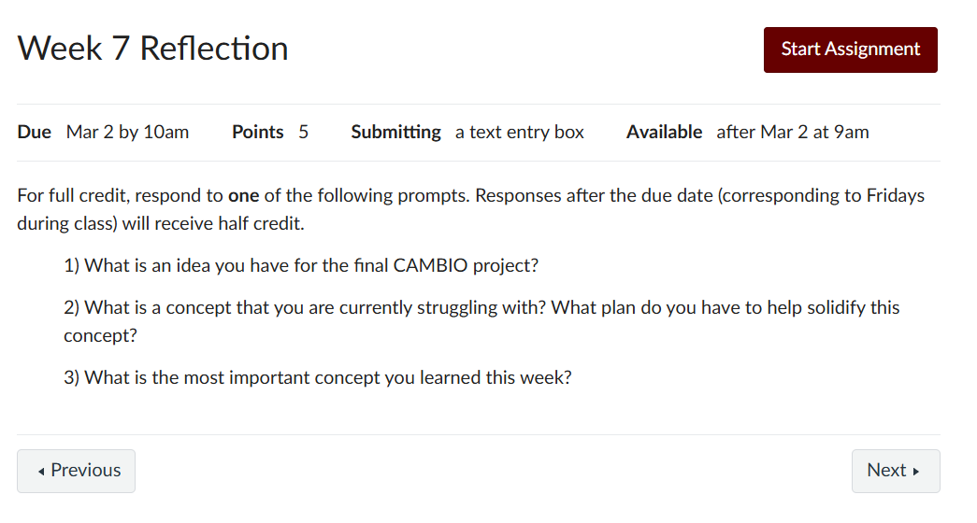
Assigning a grade for the course
Category | Significant gaps | Mostly there | Great command
CGIs
Discussion
Participation
Interviews
Project

Slide 4
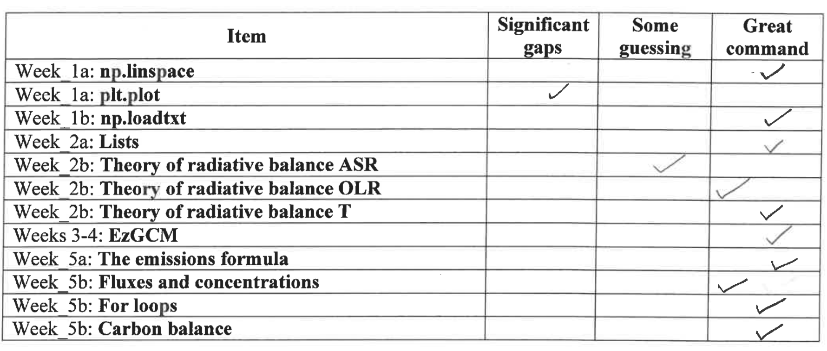
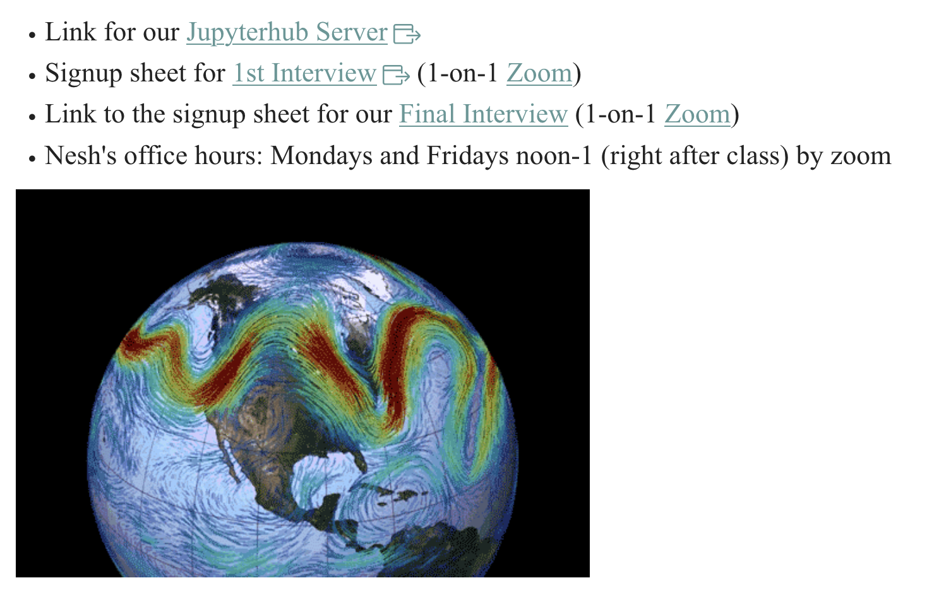
Assigning a grade for the course
Category | Significant gaps | Mostly there | Great command
CGIs
Discussion
Participation
Interviews
Project
Sign up for a slot Finals Week.

Slide 5
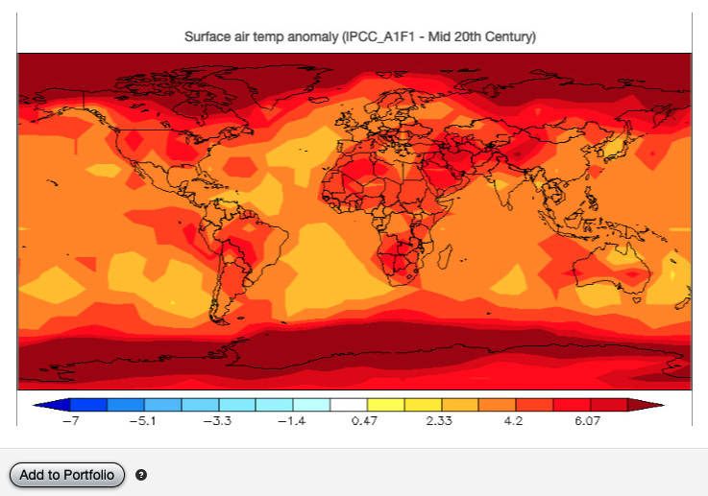
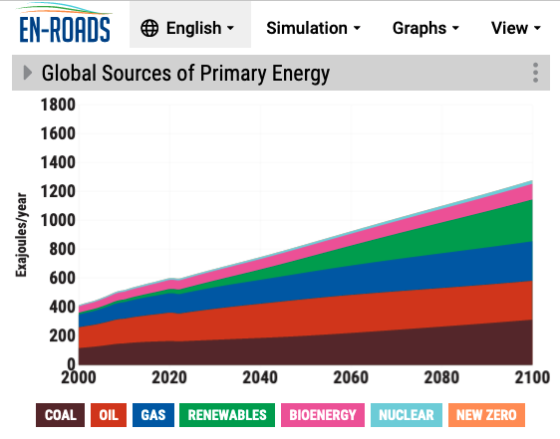
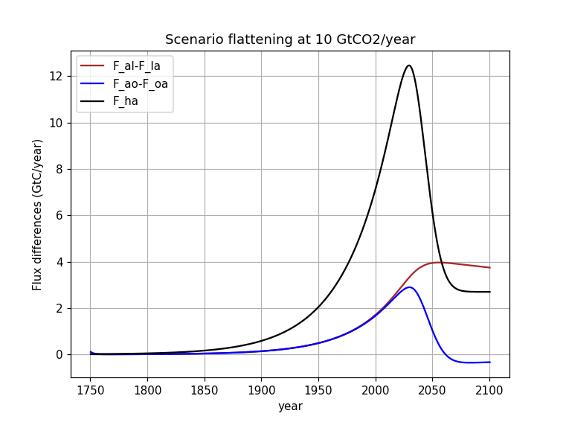
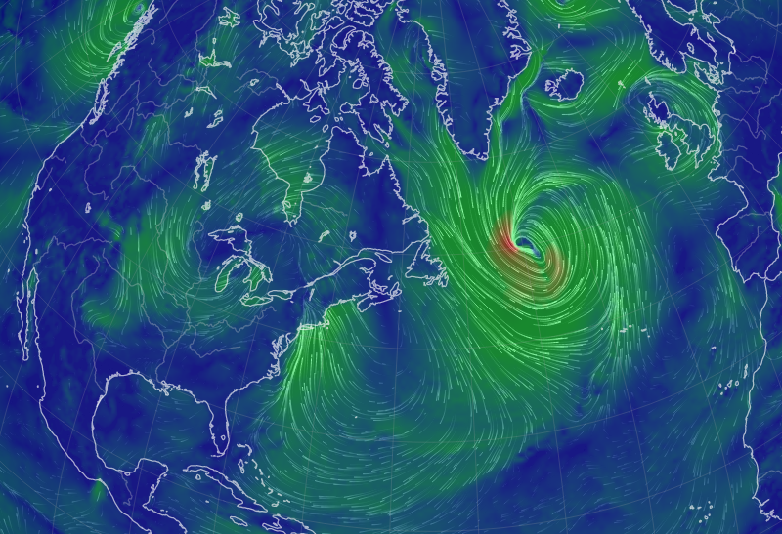
Assigning a grade for the course
Category | Significant gaps | Mostly there | Great command
CGIs
Discussion
Participation
Interviews
Project

Slide 6
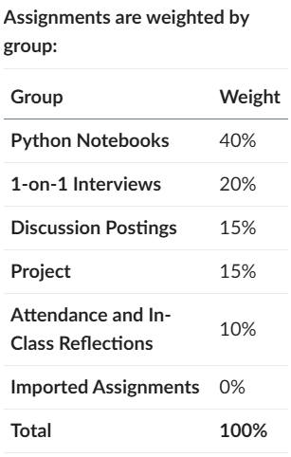
Assigning a grade for the course
Category | Significant gaps | Mostly there | Great command
CGIs |  |  | x
Discussion |  | x
Participation |  |  | x
Interviews |  |  | x
Project |  |  | x
Looks like an “A”
Category | Significant gaps | Mostly there | Great command
CGIs |  | x
Discussion |  |  | x
Participation |  | x
Interviews |  | x
Project |  |  | x
Looks like an “B”
Category | Significant gaps | Mostly there | Great command
CGIs |  | x
Discussion |  |  | x
Participation | x
Interviews | x
Project |  | x
“C” or “D”

